Slide 1
Grammar Error Correction
Team Members
Monica Patil
Bhuvesh Yadav
Rushikesh Vichare
Vinay Sanil

Slide 2
Contents
Introduction
Problems Statements
Related Research Paper
Proposed Solution
Data Summary
Important Dependencies
Project Architecture
Final Results
Conclusion
Challenges
Scope Of Improvement
Future Work
Final Demo

Slide 3
Introduction
Grammatical Error Correction as the name suggests is the process by which the detection and correction to an error in the text are done. The problem seems easy to understand but is actually tough due to the diverse vocabulary and set of rules in a language. Additionally, we are detecting the error and trying to correct.

Slide 4
Application
There are immense applications to this problem, the reason being writing is a very common means to share ideas and information. This could help the writer to speed up their work with very minimal chance of error.
Moreover, there could be many individuals who are not fluent in a particular language. Therefore, these types of models make sure that language is not a barrier in communication.

Slide 5
Problem Statement
The problem that we are dealing is a type of NLP (Natural Language Processing) problem. NLP is the field of Machine Learning which deals with the interaction between human languages and computers.
Here we tried to built an Grammar Correction App, which will detect the error and try to correct it.

Slide 6
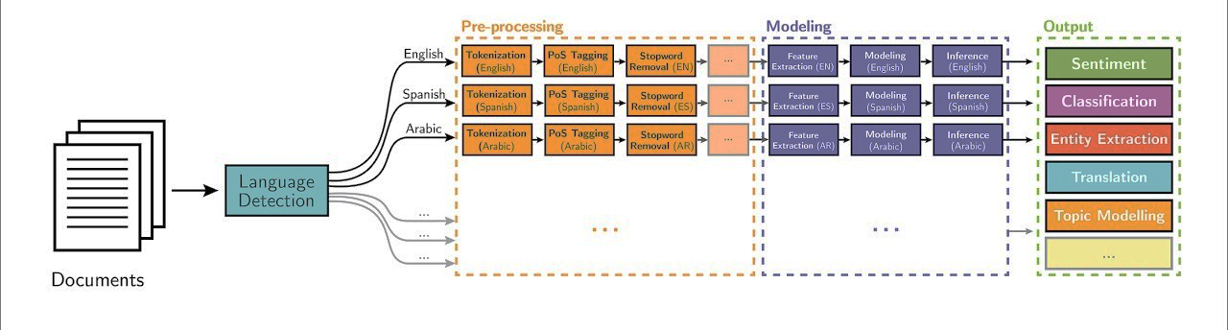
Natural Language Processing (NLP)

Slide 7
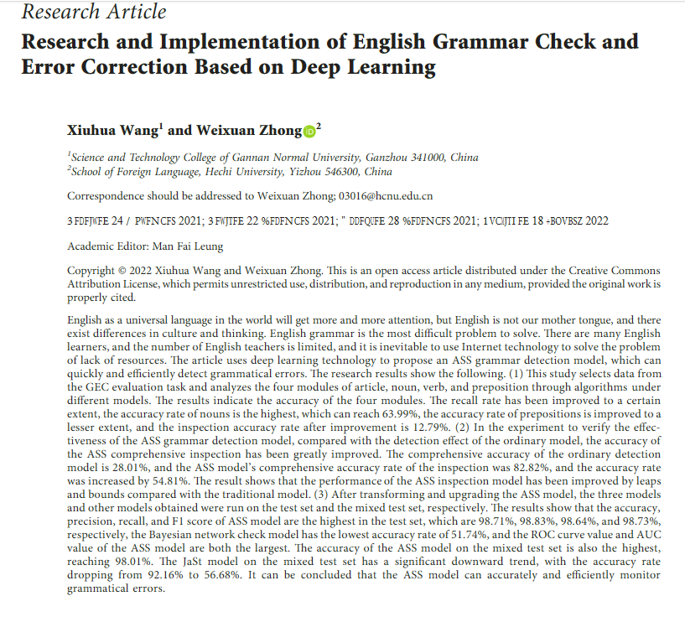
Related Research Paper - I

Slide 8
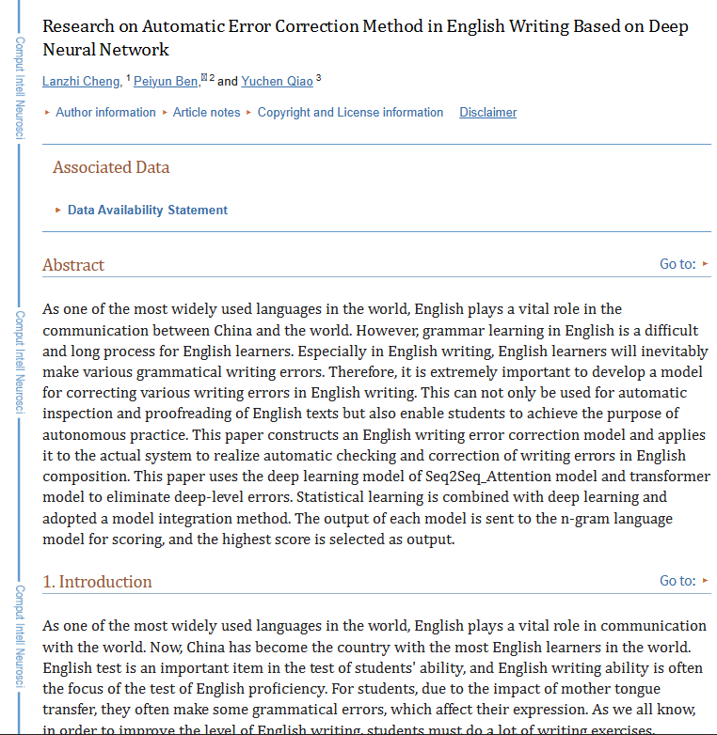
Related Research Paper - II

Slide 9
Proposed Solution
The approach that we are going to look into is the Sequence to Sequence model. In short out, the model is going to receive a sequence (incorrect text in this case) and it will output another sequence(corrected text in this case)

Slide 10
Data Summary
To generate datasets for fine-tunning the model we have used WikiEdits .This is based on corpora generation techniques.
Harvest WikiEdits from a publicly available Wikipedia edits.
Convert WikiText edits to <orig, edit> pairs using a custom script.
Filter out grammatical pairs using a ERRANT based custom script.
Used C4 based synthetic pairs.(This dataset contains synthetic training data for grammatical error correction)
Used PIE synthetic pairs.

Slide 11



Important Dependencies
Gramformer

Slide 12
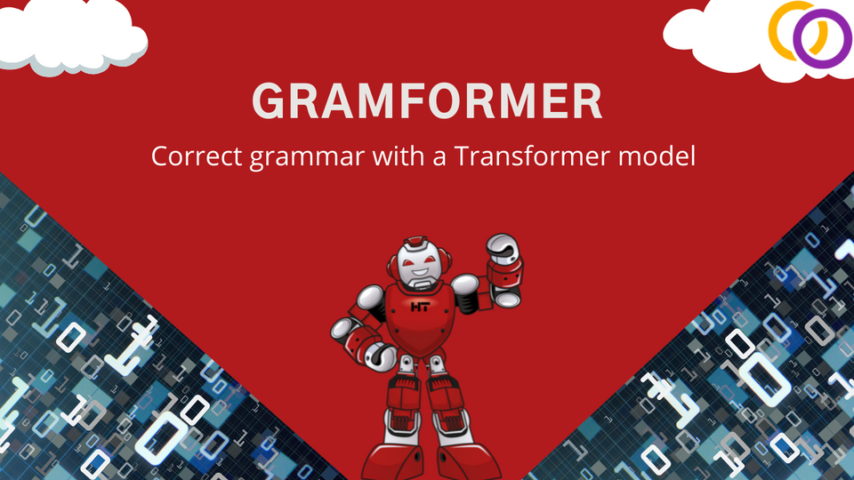

Slide 13
Gramformer
Human and machine generated text often suffer from grammatical and/or typographical errors. It can be spelling, punctuation, grammatical or word choice errors. Gramformer is a library that exposes 3 separate interfaces to a family of algorithms to detect, highlight and correct grammar errors. To make sure the corrections and highlights recommended are of high quality, it comes with a quality estimator. You can use Gramformer in one or more areas. Gramformer stands on the shoulders of giants, it combines some of the top notch researches in grammar correction.

Slide 14
How Gramformer Works?
Grammarformer is a transformer-based model that is designed to generate text that is grammatically correct. It is trained on a large dataset of text and is able to understand the rules of grammar and generate text that follows those rules. The model is trained using a variant of the transformer architecture called the Transformer-XL which is capable of capturing long-term dependencies in text.
The model generates text by predicting the next word in a sentence, based on the previous words. The model is able to take into account the grammatical structure of the input text, and generate text that follows the same structure.

Slide 15
Use cases For Gramformer
Most Supervised NLU (Chatbots and Conversational) systems need humans/experts to enter or edit text that needs to be grammatically correct otherwise the quality of HITL data can degrade the model over a period of time
Integrating into custom Text editors of your Apps.
Messaging platforms and Social platforms can highlight / correct grammatical errors automatically without altering the meaning or intent.

Slide 16

Gramformer Architecture

Slide 17
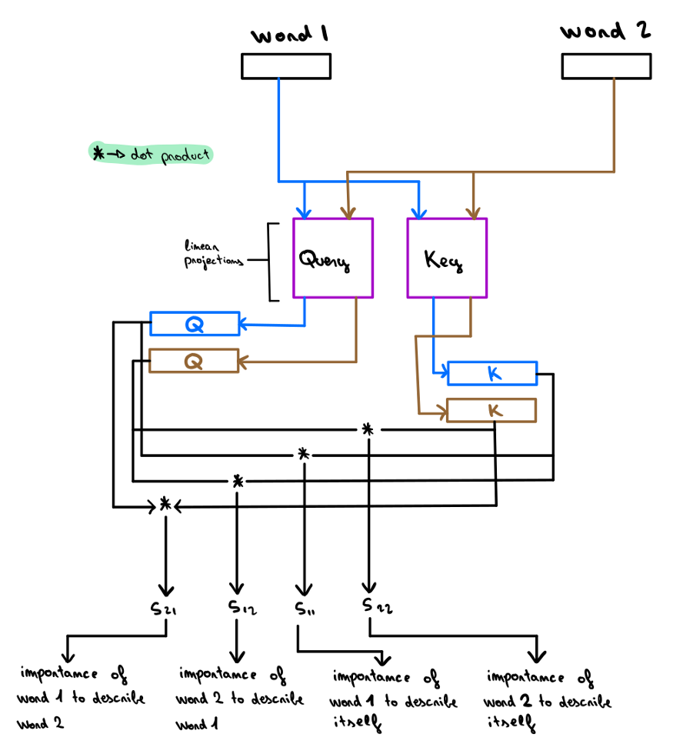
Self Attention
Self-attention will linearly project each word embedding in the input text into three different spaces, producing three new representations known as query, key and value. These new embeddings will be used to obtain a score that will represent the dependency between W and every Wn (high positive scores if W depends on W’ and high negative scores if W is not correlated with W’). This score will then be used to combine information from different Wn word embeddings, creating the updated embedding W’ for the word W.

Slide 18
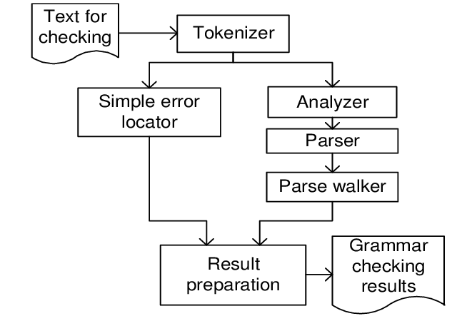
Project Architecture

Slide 19
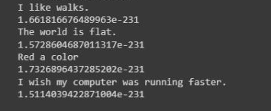
Final Results
BLEU SCORE

Slide 20
Flask is a web framework for Python. It is classified as a microframework because it does not require particular tools or libraries.
Flask provides a simple and flexible structure for creating web applications in Python. It includes routing, request and response handling, and template rendering functionality, as well as support for connecting to databases and other external resources. Flask enables developers to quickly create web applications with minimal setup and configuration, and it is often used for building RESTful APIs, web dashboards, and small web apps.

Slide 21
Flask is useful for:
Web Applications: Flask can be used to build simple to complex web applications, such as blogs, e-commerce sites, and custom web tools.
Web Dashboards: Flask can be used to create dynamic web dashboards that can display data from various sources, such as databases and APIs.
Machine Learning web-app: Flask can be used to create web-applications for Machine Learning models, such as image classification, sentiment analysis, and natural language processing.
Educational: Flask is a great framework for learning web development and it's widely used in teaching and learning web development.

Slide 22
Conclusion
Transformers solve a problem that was not limited to NLP, long-term dependencies are also important to improve Computer Vision tasks.
The Transformer model is a simple yet scalable approach that can be applied to any kind of data if it is modelized as a sequence of embeddings.
Our model is predicting the correct grammar by converting the “Bad English” to the “Good English”.
Challenges
Dataset was not available in larger size
It needs the more computational power

Slide 23
Scope for Improvement
If a better dataset is available publically that could really improve the model performance
Currently, the model is trained on basic sequence2sequence model, but if we could train the model on BERT, ROBETIA or Hugging Face., then the model could give the better performance.
Future Scope
Currently the model is working for the one or two lines. So in future, need to develop the model which can correct the Grammar for the whole paragraph or document.

Slide 24
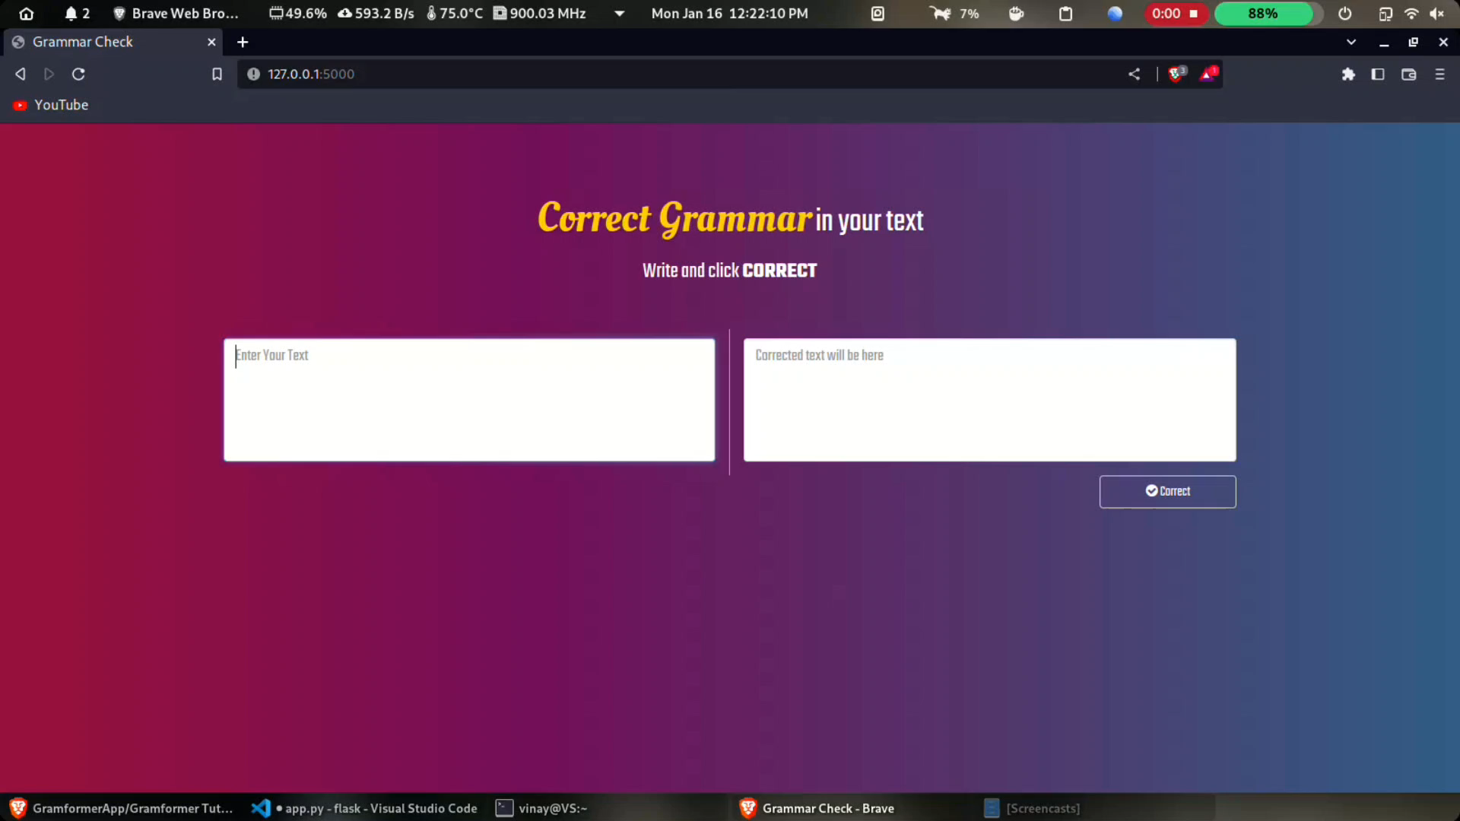
Final Demo

